Slide 1
Spinal cord injury (SCI) analysis using a Python class system
Gavin Koma, PhD Student
Advisor: Dr. Andrew Spence
Biological Models in Python, Dr. Jody Hey

Slide 2

SCI Research in Dr. Spence’s Lab
Dr. Spence’s lab focuses on locomotor neuromechanics and spinal cord injury.
He has studied and is maintaining a variety of projects which include:
Movement science via gait analysis and use of molecular genetic tools (primarily optogenetics and DREADDs)
Notes:
Dreadds will explain later

Slide 3
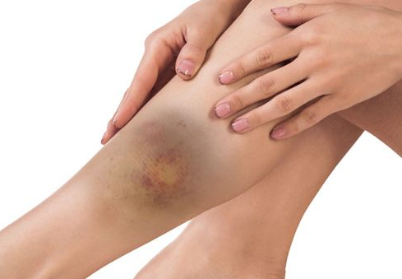
Most recent study:
Currently prioritizing a contusion study
Contusions are bruised tissues that occur when blood capillaries have been ruptured
Think punches, falls, black eyes, etc.
Spinal contusions result in bruised—contused–spinal tissue and subsequently causes a variety of movement issues

Slide 4
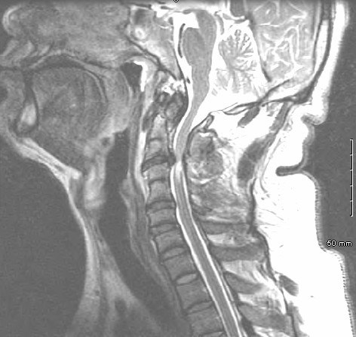
Spinal cord injuries and spinal contusions
Two main categories of spinal cord injuries (SCIs)
Complete – occurs when the tissue of the cord is entirely severed
Incomplete – occurs when the tissue is damaged but still spared
Incomplete spinal cord injuries result in a loss of motion (but not complete loss) below the affected area.
Most commonly occur in elderly patients after a traumatic fall or event

Slide 5
DREADDs, a brief overview:
The Spence lab utilizes DREADDs (Designer Receptors Exclusively Activated by Designer Drugs) to target specific neural activation
These drugs bypass all off-target effects, since they are not found anywhere in the body
The Designer Drug only activates the Designer Receptor
To summarize, we place receptors that have no effect on the body in a location that has neurons that we want to influence and then inject an inert ligand that will activate (or inhibit) our neurons of focus.

Slide 6
Experimental setup:
The rats are trained to walk for short bursts of time on an automated treadmill
Done via behavioral training, motivated with Reese’s Puffs
Gait analysis recorded over 5 different speeds with their natural gait (19.7 cm/s) as the median speed
Gait recordings begin at week 3 after the contusion (full 8 weeks of training)
Studies on week 6, week 7, and week 8 to study the effects of withdrawal from treatment
Notes:
We perform the contusion and then start recording after
We use week 7 to study the effects of stopping the activation of the DREADDs

Slide 7
Experimental hypothesis:
The experimental rats have DREADDs
DREADDs are a class of artificially engineered protein receptors that are selectively activated by certain ligands
The control rats receive the activator drug but lack the designer receptors
We hope to see an increase in motion of the lower limbs of the rats post-DREADD infusion and a near-stagnant recovery of the rats that do not have DREADDs infused
It will be important to note the improvement of the control rats as well to ensure that our activator drug is not causing improvement on its own

Slide 8
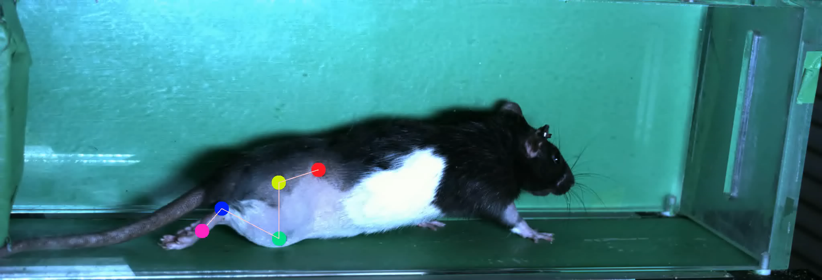
Gait of rat post-contusion surgery (week 6):
Recording of rat 405’s gait after its contusion surgery.
Notes:
Week 6 stage of the recovery which is where they begin to plateau

Slide 9
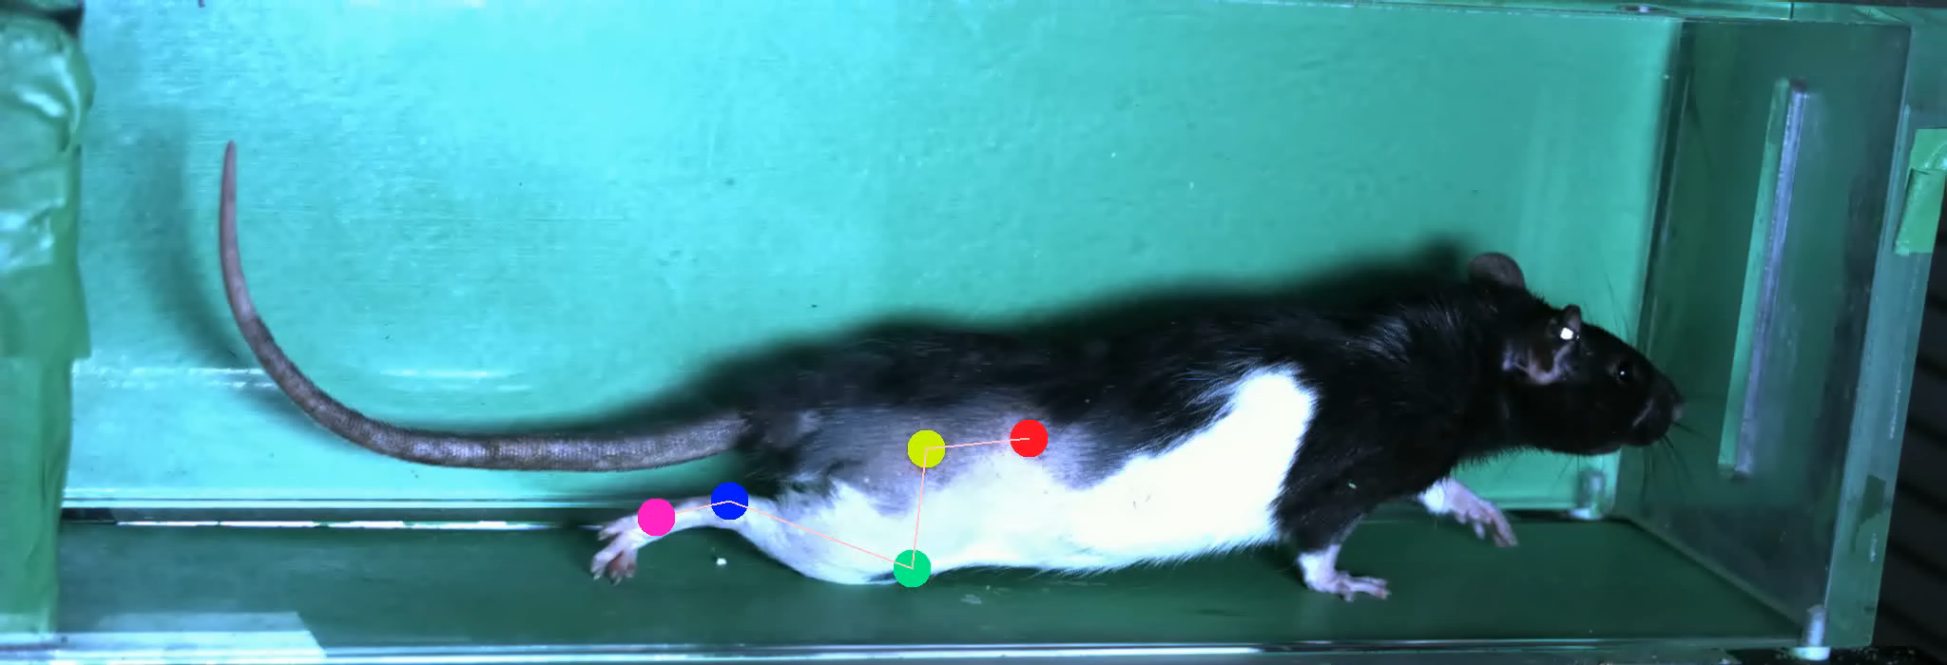
Gait of rat post-contusion surgery (week 8):
Recording of rat 405’s gait after its contusion surgery.
Notes:
See to find red dot that does not move

Slide 10
Final Project Proposal:
Implement a class that loads and analyzes the certain factors from the most recent contusion study
Perform a two-way repeated measures ANOVA on the control and experimental groups’ asis height of weeks 6, 7, and 8
Perform two separate t-tests that study the angle of the ankle and the step duration of the rats during week 6
Output three graphs total:
1. ANOVA graph
2. Ankle angle t-test graph
3. Step duration t-test graph

Slide 11
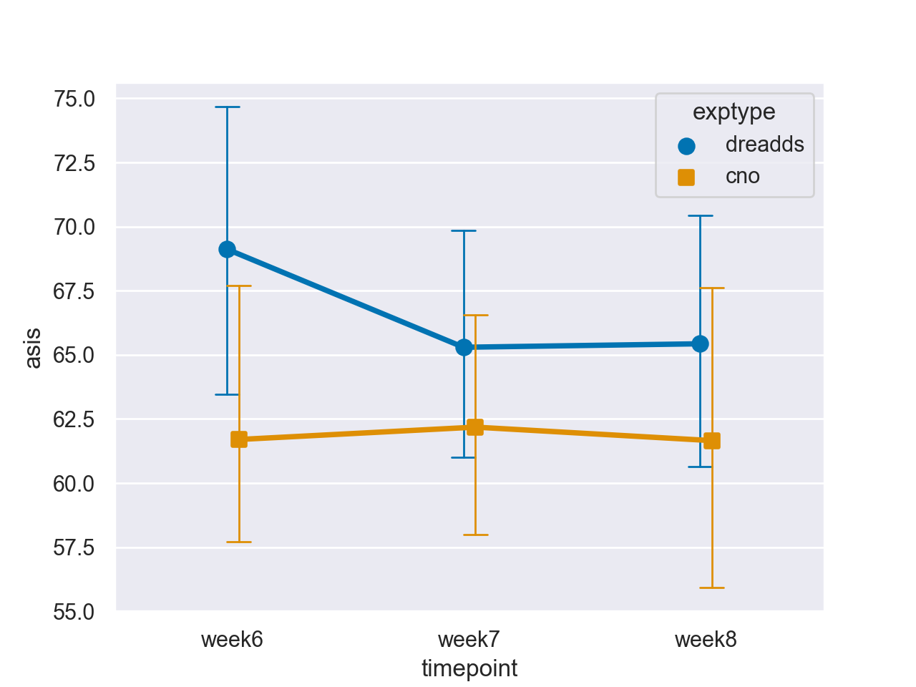
Two-way Repeated Measures ANOVA
Expectations:
Control group was expected to stay stagnant during all three recovery weeks showing little to no improvement post-surgery
Experimental group was expected to show a large drop in mobility in week 7 but a spike to the same level of mobility after week 6
While we properly expected the control group’s recovery map, we see there is no improvement in week 8 for the experimental mice
Experimental group p-val: 0.5579
Control group p-val: 0.9899
Notes:
Significance instead of pval, add more subjects

Slide 12
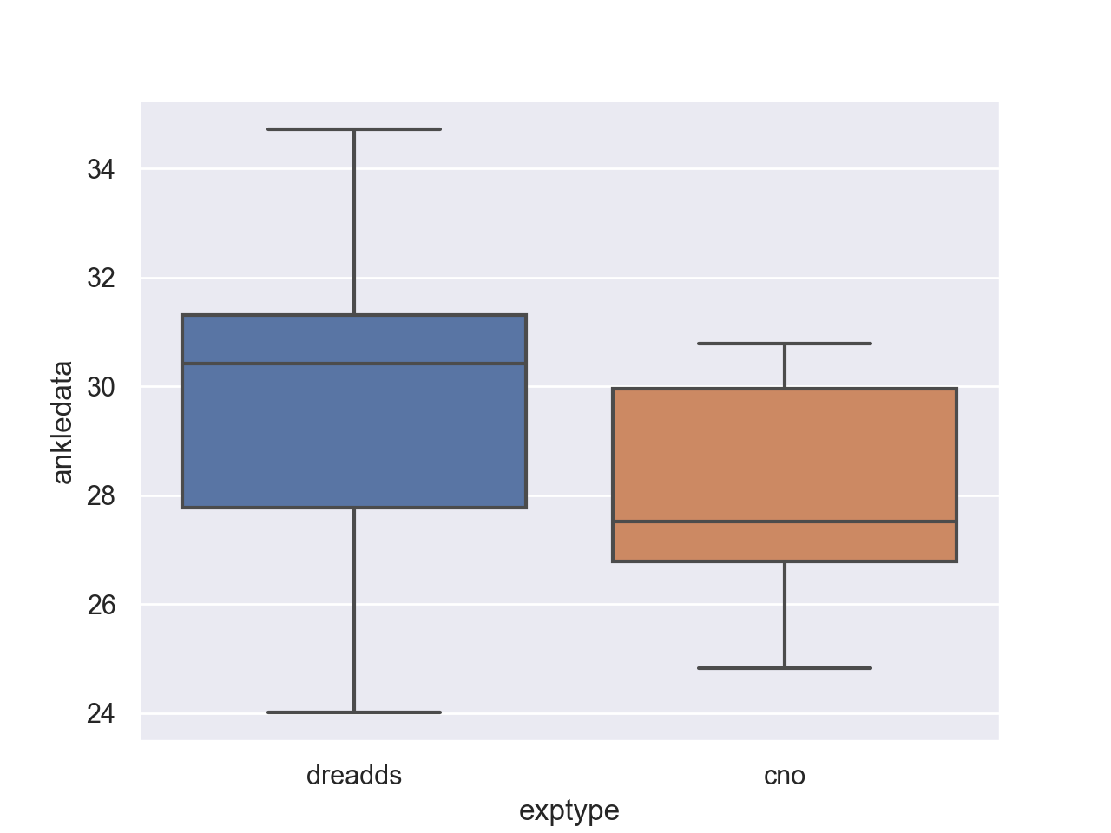
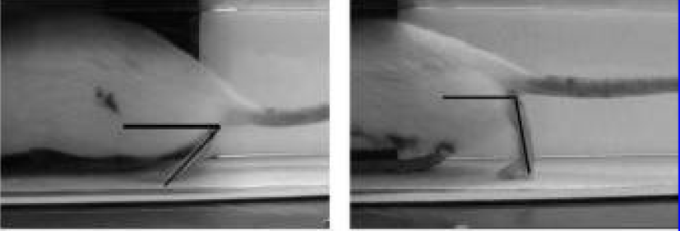
Ankle angle t-test:
This test will compare the angle of the ankle during gait at the rat’s most comfortable speed
This is the angle between the toes and the knee
We would expect the rats that have DREADDs infused to have more mobility than the control rats
Calculated p-val: 0.5365

Slide 13
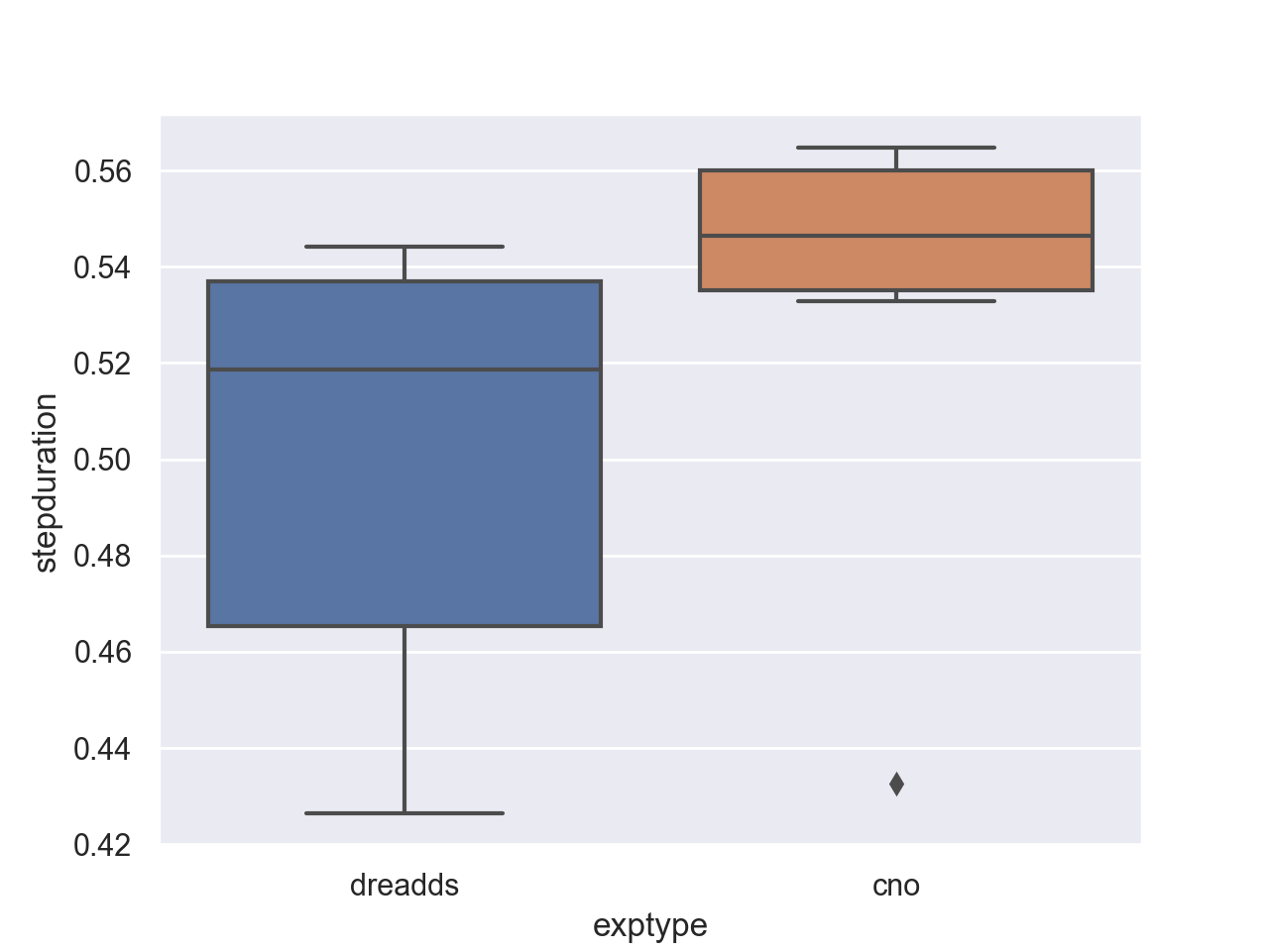
Step duration t-test:
This test will compare the duration of stride of the control and experimental groups
Stride duration is measured when the back right toe lifts off the ground until the toe is placed back down after the stride
We expected the DREADD-infused rats to have notably faster strides, implying that their gait perception was improving as a byproduct of DREADD infusion
We do see faster stride duration in DREADD-infused rats, but due to a small sample size, we cannot be sure that it is truly significant yet.
T-test p-val: 0.2525

Slide 14
Conclusions:
For the DREADD animals, the withdrawal of CNO (our activator drug) seems to have little effect on mobility, specifically on the asis height
This is disappointing because we had hoped to see a notable increase in the general mobility of the rats
We receive good news, however, from our control group that saw no improvement at all
This means that our activation drug is not causing any independent changes in mobility
This ensures that our use of DREADDs and CNO are entirely dependent on each other and is a very good factor to check
Notes:
Suggests that it doesn’t do anything because of a small population number, will be adding more population

Slide 15

Future plans:
Perform another batch of experiments to increase control population
Cross-analyze other gait parameters such as knee angle, knee height, stride length, etc.
Hopefully, we will see a notable improvement in another parameter that we overlooked initially that occurs as a byproduct of DREADD use

Slide 16

Acknowledgements:
Dr. Andrew Spence
Dr. Jody Hey
George Moukarzel, PhD Candidate
Kathy Keefe, PhD

